Slide 1
Week 1 Introduction to RNA sequencing
CASE STUDIES IN FUNCTIONAL GENOMICS

Slide 2
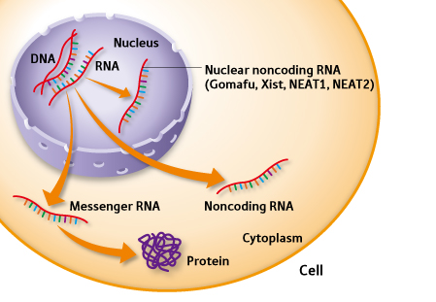
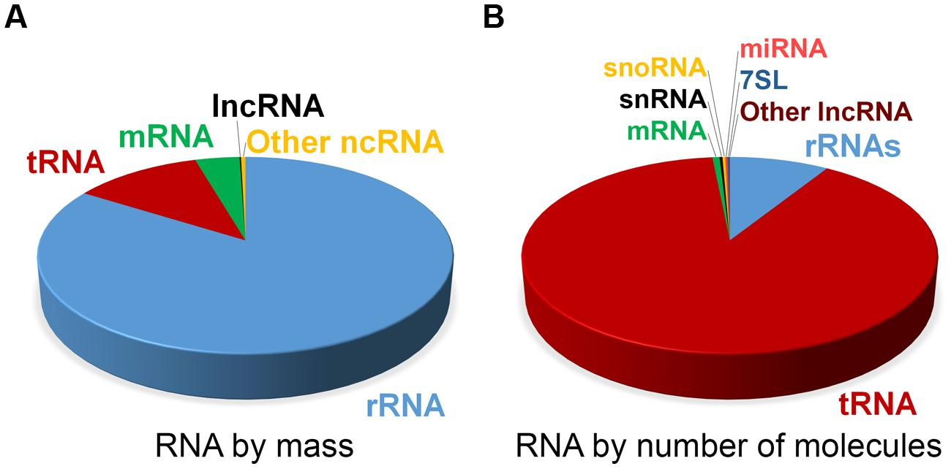
RNA Isolation

Slide 3
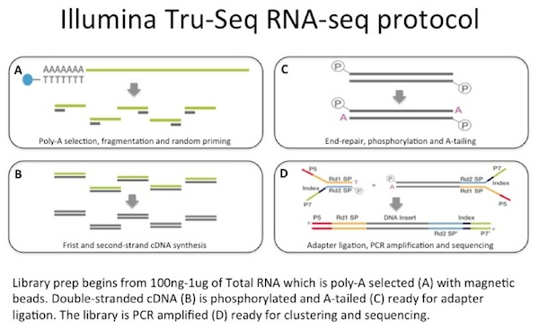
Filtering for mRNA

Slide 4
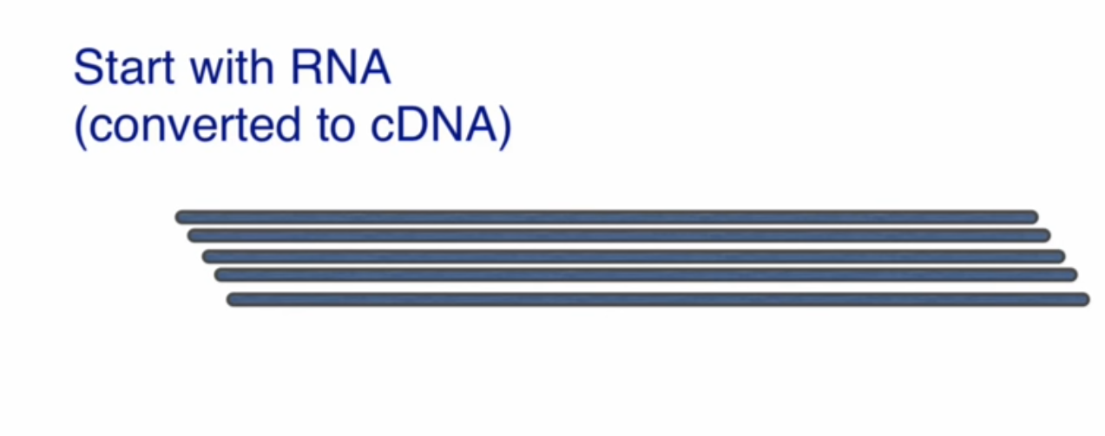

Slide 5
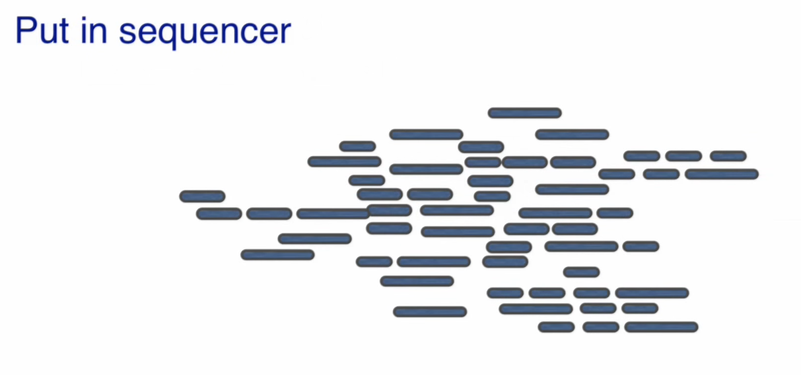
Obtain reads ….

Slide 6
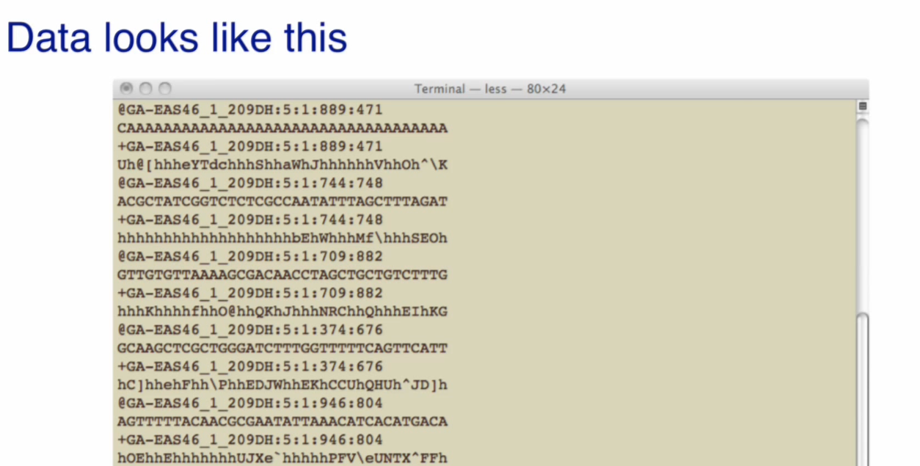
… which look like this (fastq format)

Slide 7
We can then map the reads to the reference genome with the aligners that we’ve discussed during previous classes.

Slide 8
Analysis: difference from microarray
Counts instead of intensities
Poisson or Binomial distribution will be used

Slide 9
The sequences of RNA transcripts aren’t exactly represented on the genome

Slide 11
Count the number of reads mapped to a gene/exon
Determine from the reads what transcripts are present.

Slide 12
Data generation and counts
#2

Slide 13
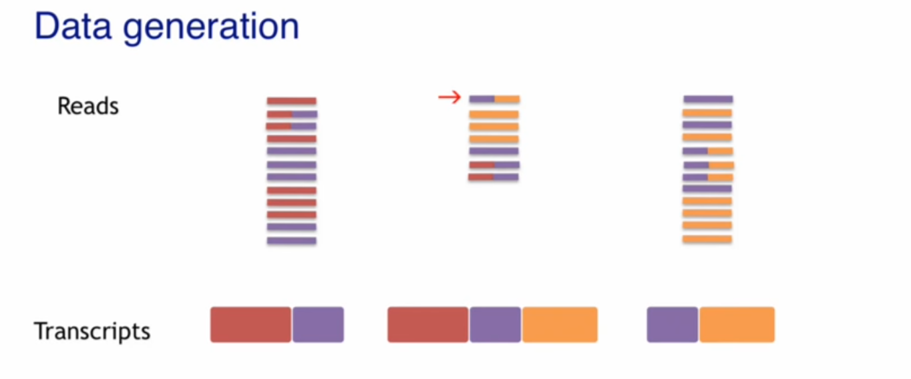
Challenge: can we reconstruct the transcripts from the reads?

Slide 14
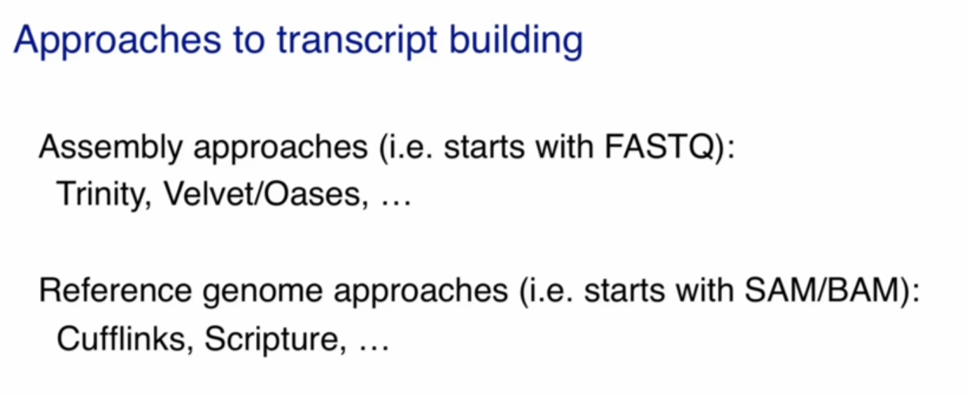

Slide 15
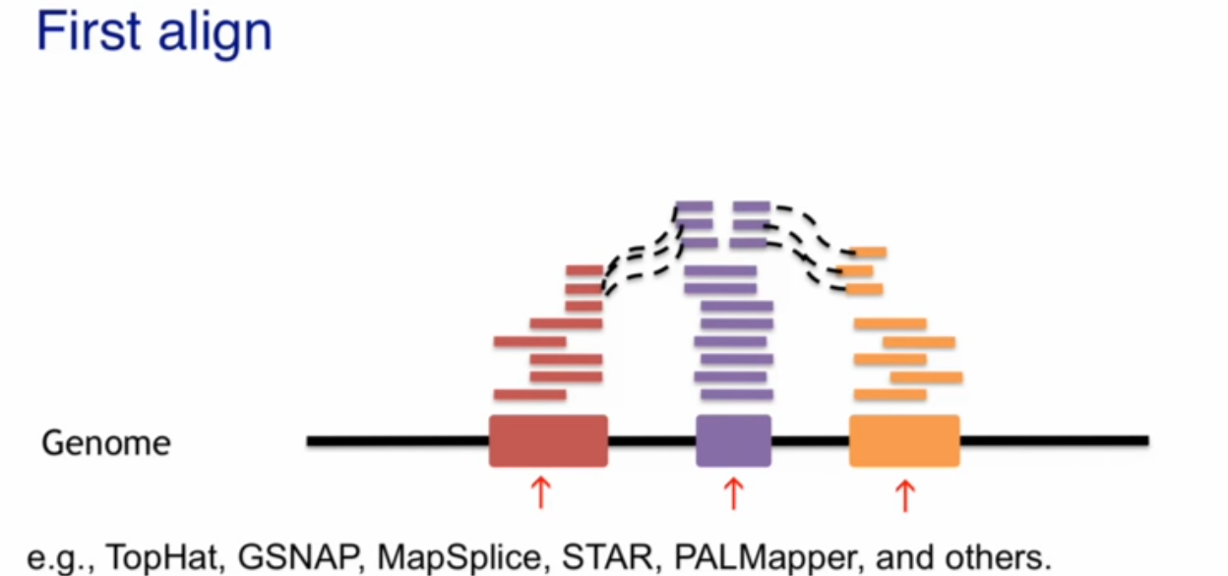

Slide 16
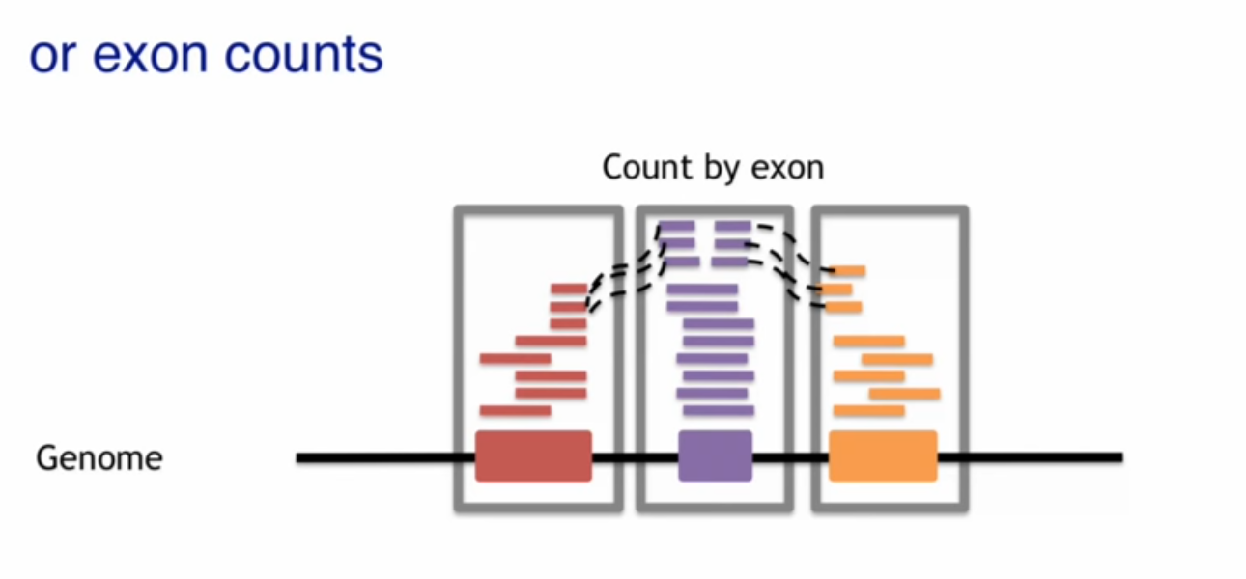

Slide 17
Model for Quantification
#3

Slide 18
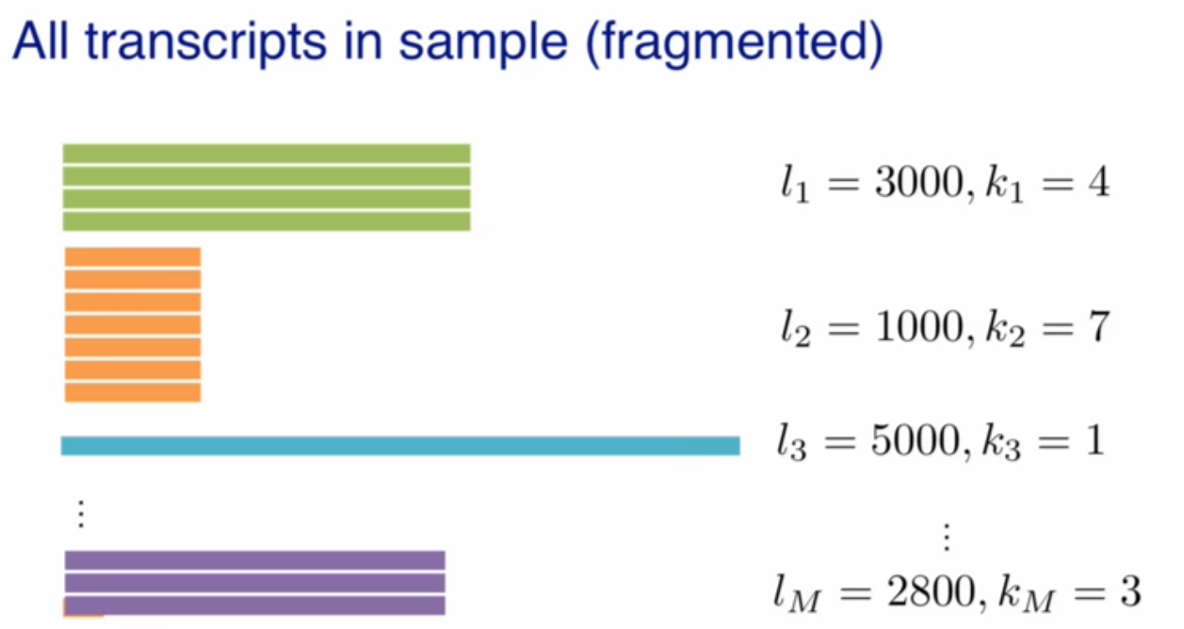

Slide 19
Lengths are important

Slide 20
The model
let G be the set of genes
for any gene g∈G , let F_{g}={f_{g,i} | i∈[1,n_{g}]}
let F ={f_{g,i}| g∈G, i∈[1,n_{g}]} = set of all isoforms of all genes
for any isoform f ∈F:
l_{f} = its length
k_{f} = number of transcripts f in the sample
$\sum_{\text{f} \text{∈}\text{F}}{\text{k}\text{f} \text{lf} }$ = total length of transcripts in the sample
p_{f} =k_{f} l_{f} / $\sum_{\text{f} \text{∈}\text{F}}{\text{k}\text{f} \text{lf} }$ = probability that a read comes from f
Define: Θ_{f} =k_{f} / $\sum_{\text{f} \text{∈}\text{F}}{\text{k}\text{f} \text{lf} }$ = expression index of isoform f
p_{f} =Θ_{f} l_{f}
$\sum_{\text{f} \text{∈}\text{F}}{\text{Θ}\text{f} \text{lf}}$ = 1

Slide 21
Statistical model for transcript determination
Probability that a read comes from transcript f

Slide 22
Number of reads coming from transcript f.

Slide 23
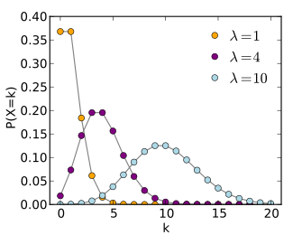
Poisson distribution
number of times an event occurs in an interval of time or space.

Slide 24
Model for quantification assessment
Exercise #2

Slide 25
Transcript Quantification
#4

Slide 26
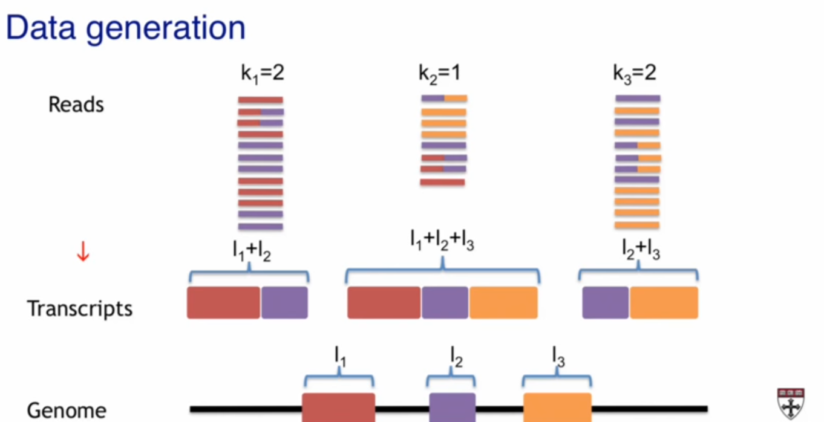

Slide 27
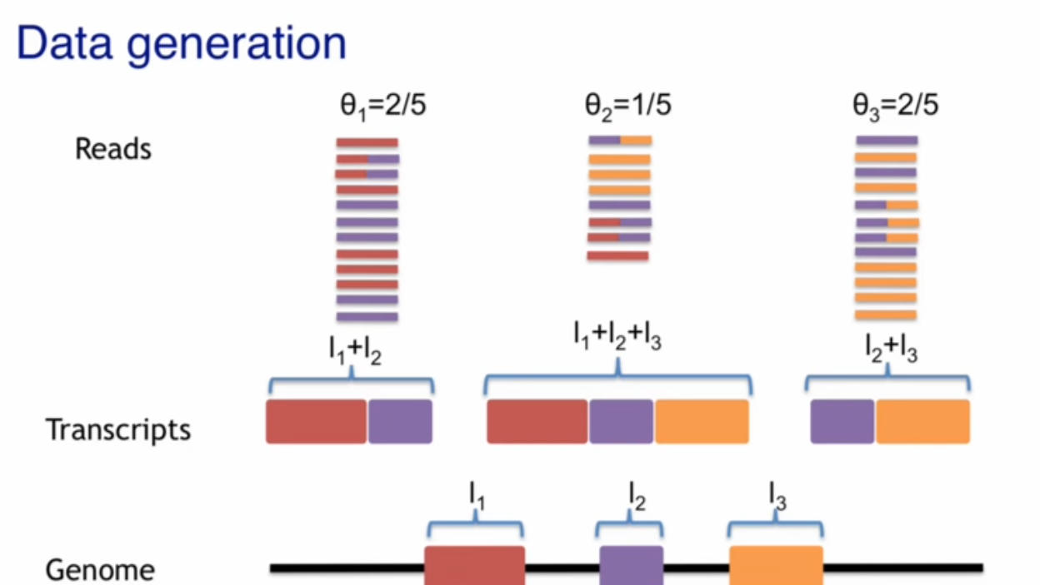
Θ₁ = 2/(3l₁ + 5l₂ + 3l₃)

Slide 28
What we actually have is

Slide 29
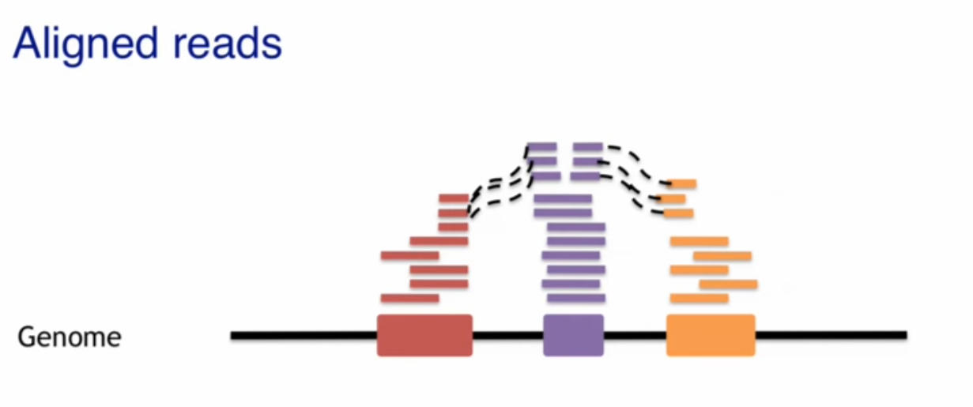
We don’t know what transcripts are there

Slide 30
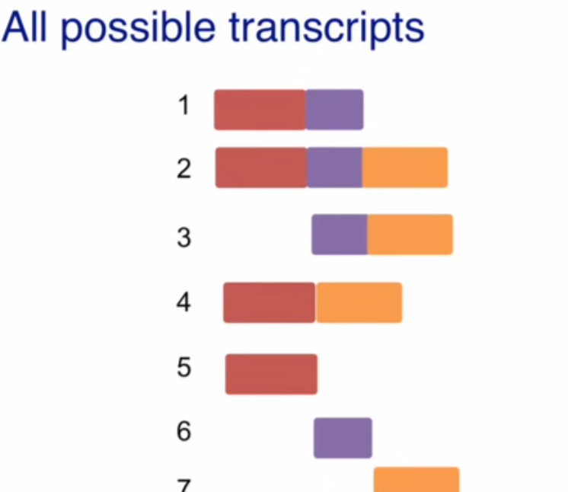
We consider all possible transcripts

Slide 31
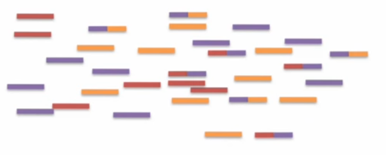
We eliminate transcripts that we think are not possible

Slide 32
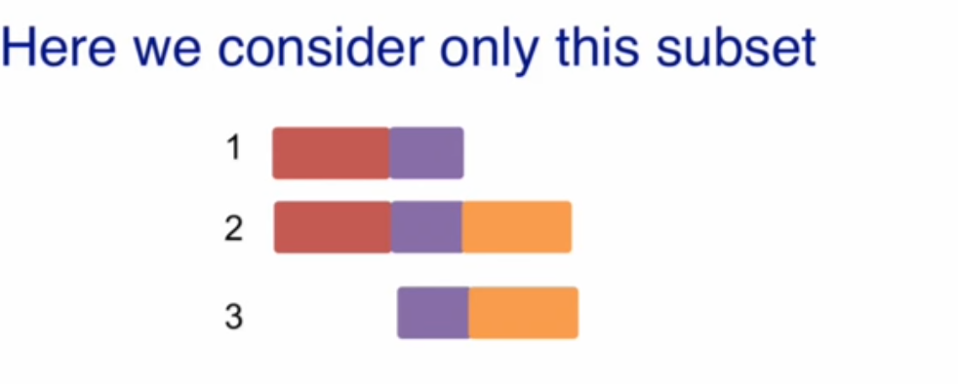
For illustration we only take these three
Note: different software make the possible transcript choice differently

Slide 33
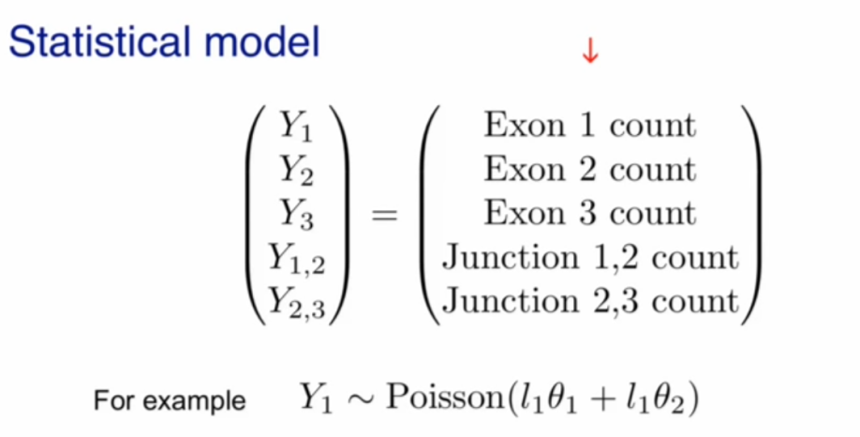
Statistical model
Let w be the total number of mapped reads.
The probabilty of reads falling into region of length l in transcript f follows Poisson with parameter:
λ=wθ_{f} l
For a gene g, suppose
- m exons with lengths L=[l₁,l₂,...,l_{m}]
n isoforms with expressions =[Θ₁,Θ₂,...,Θ_{n}],
cij is 1 if isoform i contains exon j and 0 otherwise
λ for the number of reads falling into exon j is:
λ = l_{j}w $\sum_{i=1}^{n}{cijθi}$
c_{i,j} ‘s
For exon (j)-exon (k) junctions with length l:
λ = lw $\sum_{i=1}^{n}{cijcikθi}$

Slide 34
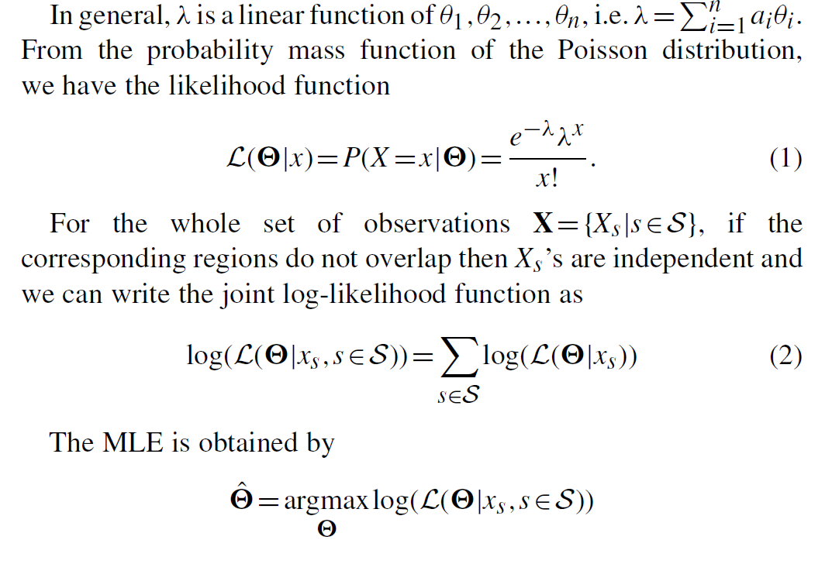
Statistical model

Slide 35
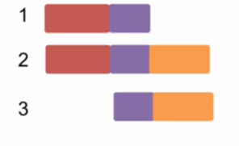

Slide 36
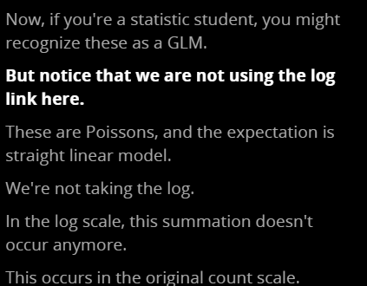
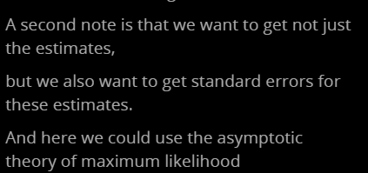

Slide 37
Transcript quantification assessment
Exercies #3

Slide 38
Unstable Quantification
#5

Slide 39
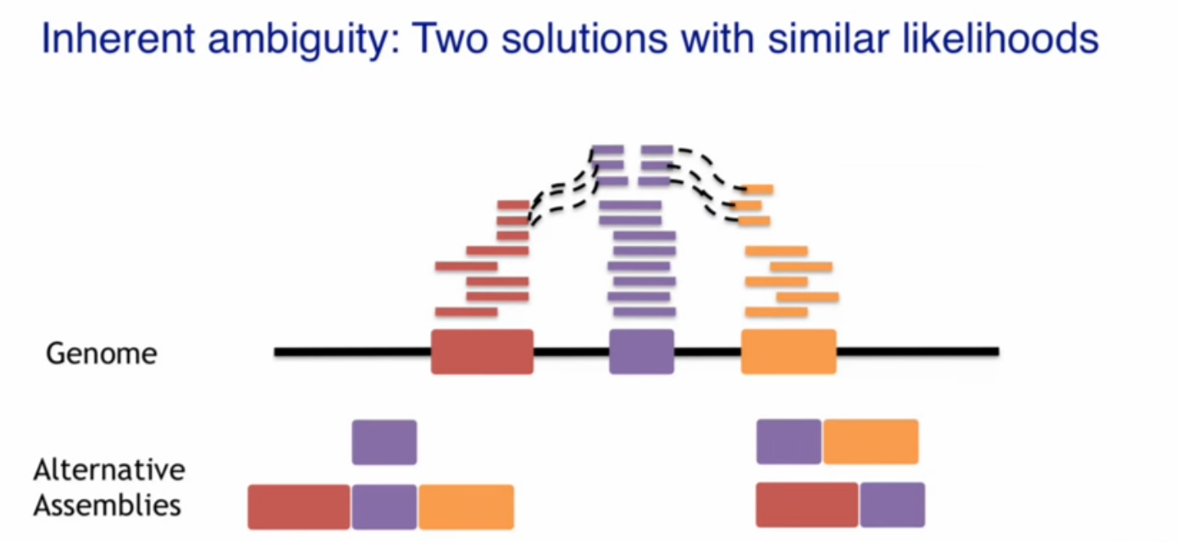

Slide 40
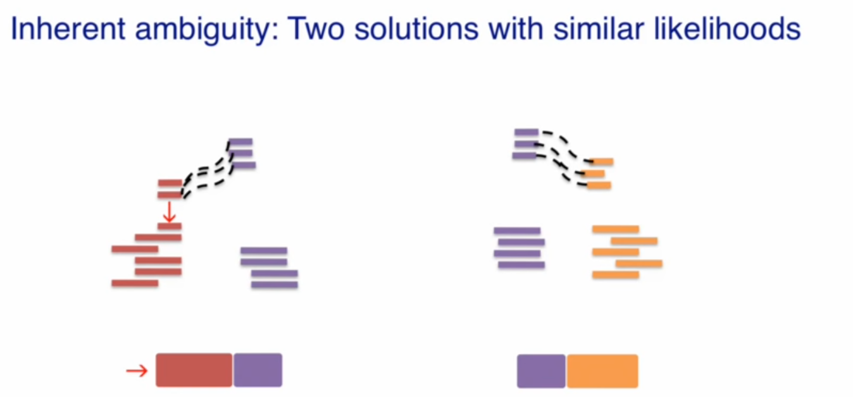
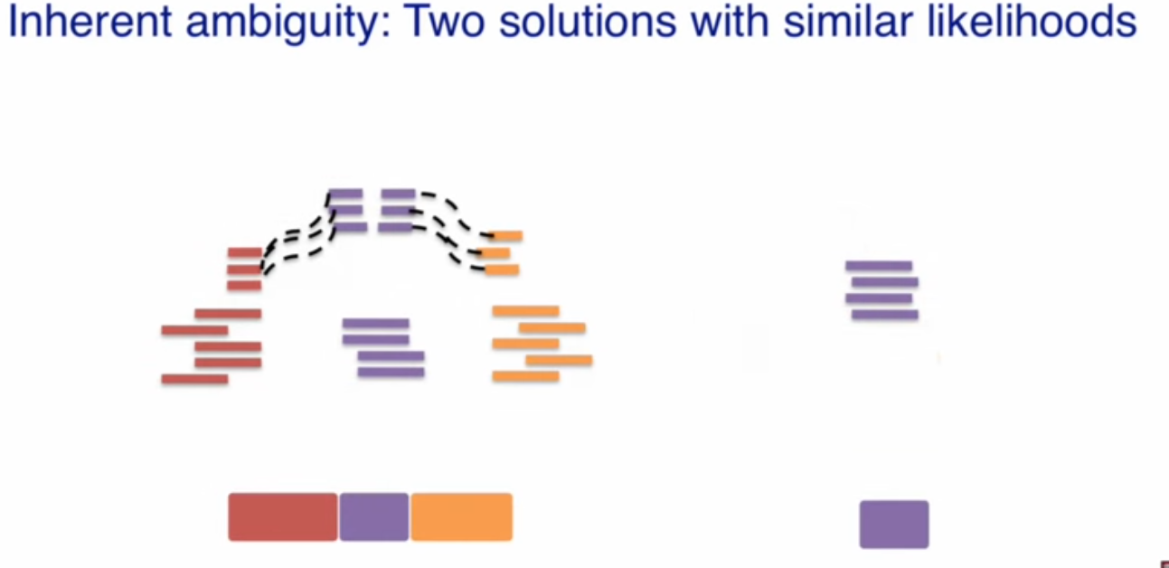

Slide 41
If the estimates are similar for the two models it is likely that just by chance one transcript is assumed to be expressed in one sample and a different transcript in another sample
The problem:

Slide 42
This is real data. This gene has only one transcript. The non-uniform distribution of reads is explained by genomic location/sequence, and the technology-related biases.

Slide 43
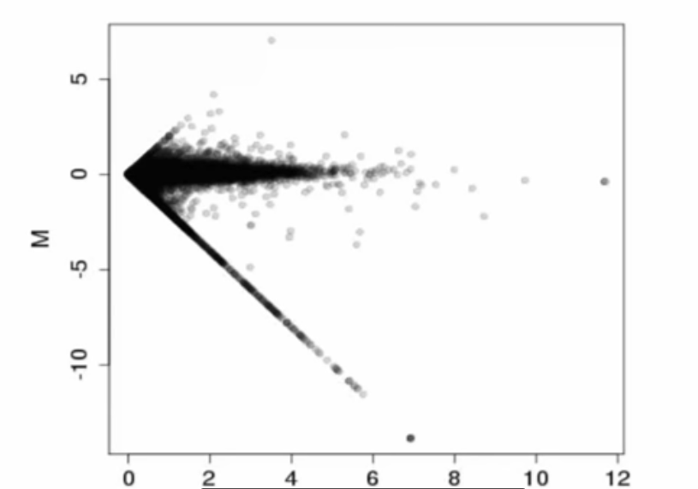
R = 0
M = -logG
A = ½ logG

